Slide 1
Chapter 9: GRAVITY

Slide 2
In this lecture …
The Universal Law of Gravity
The Universal Gravitational Constant
Gravity and Distance : Inverse-Square Law
Weight and Weightlessness

Slide 3
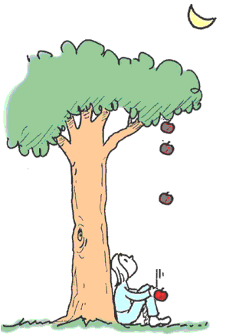
Gravitational Force
Legend—Newton, sitting
under an apple tree, observed an apple falling from a tree.
The apple accelerated.
There must be a force acts on the apple to cause this acceleration.
This force is called ‘Gravity’ or ‘Gravitational Force’ (Unit: N)
g is the acceleration due to gravity, not a force. (Unit: m/s²)

Slide 4
What if the apple tree is twice as high?
The apple will still accelerate toward the ground.
The force of gravity reaches to the top of the highest tree !
The force of gravity reaches all the way to the moon & beyond (The orbit of the Moon about the Earth is a consequence of the gravitational force)

Slide 5
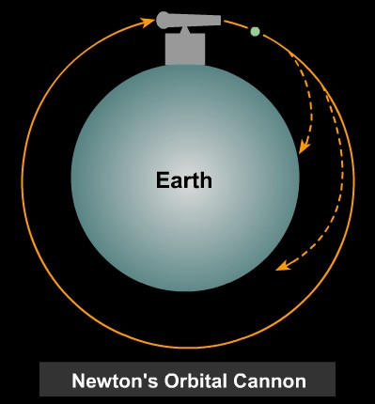
If we fire a cannon horizontally as shown in the figure, the projectile will eventually fall to earth (shortest trajectory), because of the gravitational force directed toward the center of the Earth and the associated acceleration.
If fired with the right velocity, the projectile would travel completely around the Earth.
The it would fall around the earth because of the acceleration due to gravitational force.
→ any two objects in the Universe exert gravitational attraction on each other.
http://csep10.phys.utk.edu/astr161/lect/history/newtongrav.html

Slide 6
Newtonian synthesis
The same set of laws apply to both celestial and terrestrial objects.

Slide 7
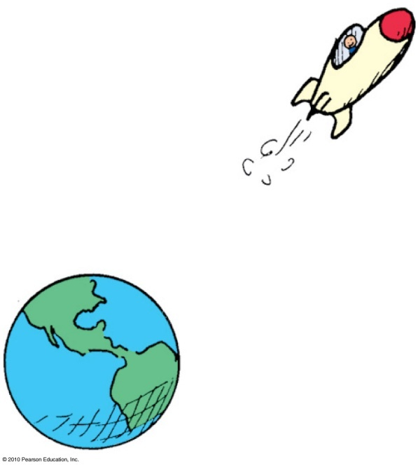
The Universal Law of Gravity
Law of universal gravitation:
Everything pulls on everything else.
Every body attracts every other body with a force that is directly proportional to the product of their masses and inversely proportional to the square of the distance separating them.

Slide 8
The Universal Law of Gravity
In equation form:
where m is the mass of the objects and d is the distance between their centers.
Examples:
    The greater the masses m₁ and m₂ of two bodies, the greater the force of attraction between them.
    The greater the distance of separation d, the weaker the force of attraction.
mass
×
mass
m
m
Force
~
₁
₂
or
F
~
₁
₂
distance
d
²
²

Slide 9
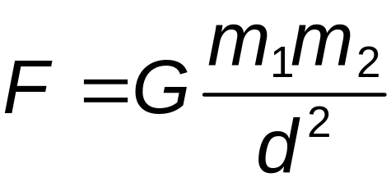
The Universal Gravitational Constant, G
Gravity is the weakest of four known fundamental forces
With the gravitational constant G, we have the equation
Universal gravitational constant:
G = 6.67 × 10⁻¹¹ Nm²/kg²

Slide 10
Gravity and Distance:
The Inverse-Square Law
Inverse-square law:
relates the intensity of an effect to the inverse- square of the distance from the cause.
in equation form: intensity = 1/distance².
for increases in distance, there are decreases in force.
even at great distances, force approaches but never reaches zero.

Slide 11
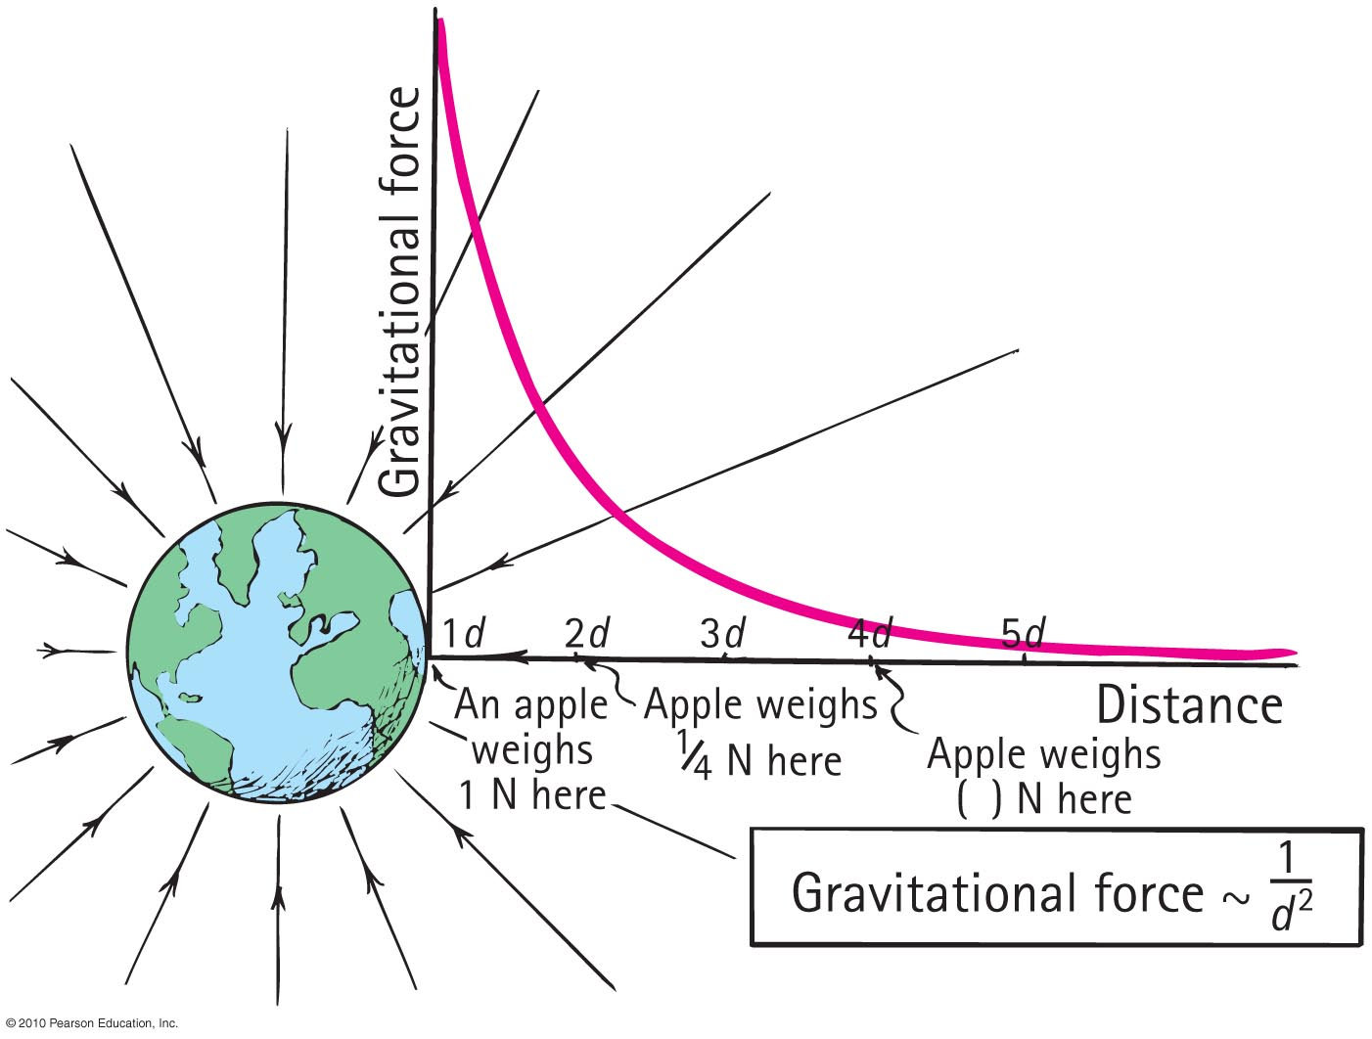
Inverse-Square Law

Slide 12
The force of gravity between two planets depends on their
A. masses and distance apart.
planetary atmospheres.
rotational motions.
All of the above.

Slide 13
The force of gravity between two planets depends on their
A. masses and distance apart.
planetary atmospheres.
rotational motions.
All of the above.
Explanation:
The equation for gravitational force,
cites only masses and distances as
variables. Rotation and atmospheres
are irrelevant.

Slide 14
If the masses of two planets are each somehow doubled, the force of gravity between them
A. doubles.
quadruples.
reduces by half.
reduces by one-quarter.

Slide 15
If the masses of two planets are each somehow doubled, the force of gravity between them
A. doubles.
quadruples.
reduces by half.
reduces by one-quarter.
Explanation:
Note that both masses double. Then, double × double = quadruple.

Slide 16
If the mass of one planet is somehow doubled, the force of gravity between it and a neighboring planet
A. doubles.
quadruples
reduces by half.
reduces by one-quarter.

Slide 17
If the mass of one planet is somehow doubled, the force of gravity between it and a neighboring planet
A. doubles.
quadruples.
reduces by half.
reduces by one-quarter.
Explanation:
Let the equation guide your thinking:
Note that if one mass doubles, then
the force between them doubles.

Slide 18
Weight and Weightlessness
Weight:
force an object exerts against a supporting surface
  Examples:
  standing on a scale in an elevator accelerating downward, less compression in scale springs; weight is less
  standing on a scale in an elevator accelerating upward, more compression in scale springs; weight is greater
  at constant speed in an elevator, no change in weight

Slide 19
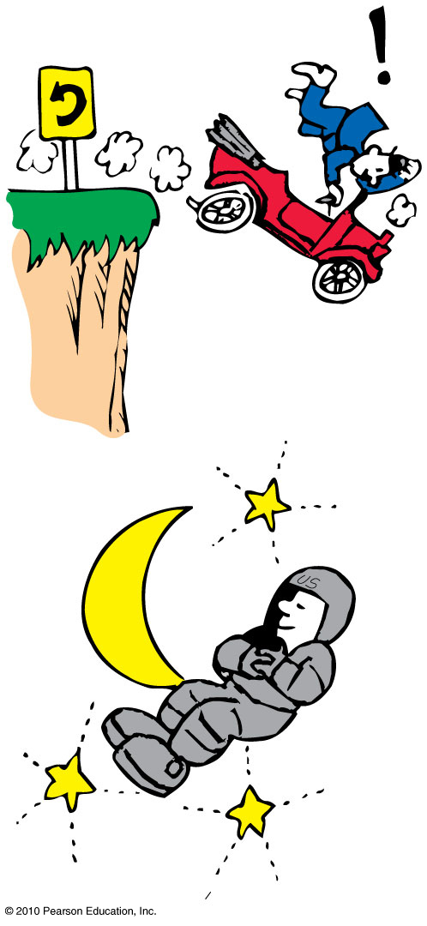
Weight and Weightlessness
  Weight = force that an object exerts on a supporting surface
No support force → no weight
( gravity g still exists !!!)
Weightlessness = absence of a support force
Example : free fall
Example: Astronauts in orbit are without support forces and are in a continual state of weightlessness.

Slide 20
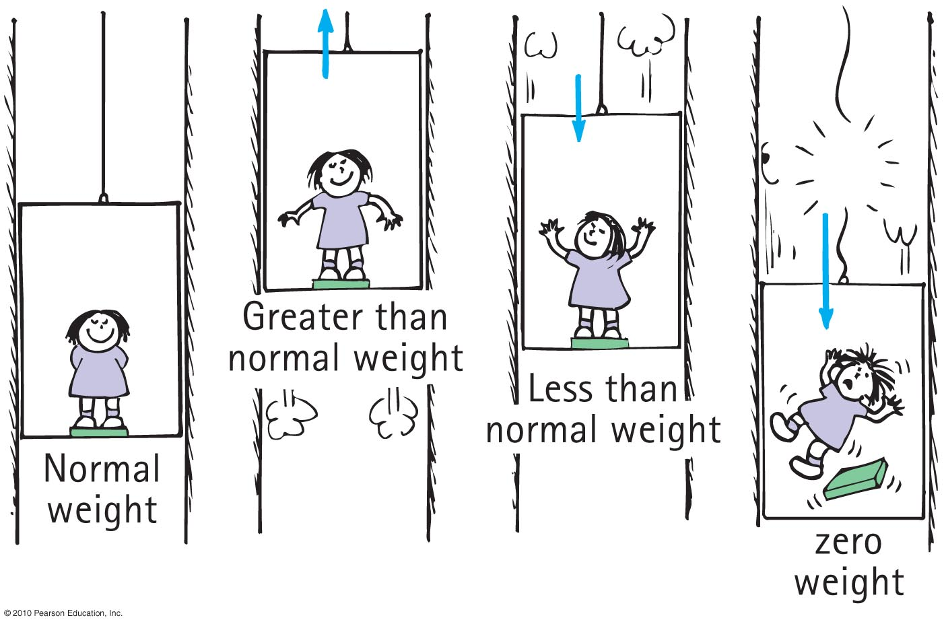
Weight and Weightlessness
When you stand on a stationary bathroom scale , you exerts a force on the scale and
the floor. At the same time, the floor and the scale push upward on you.
The compression of springs inside the scale = your weight
More compression = higher weight reading

Slide 21
When an elevator accelerates upward, your weight reading on a scale is
A. greater.
less.
zero.
the normal weight.

Slide 22
When an elevator accelerates upward, your weight reading on a scale is
A. greater.
less.
zero.
the normal weight.
Explanation:
The support force pressing on you is greater, so you weigh more.

Slide 23
When an elevator accelerates downward, your weight reading is
A. greater.
less.
zero.
the normal weight.

Slide 24
When an elevator accelerates downward, your weight reading is
A. greater.
less.
zero.
the normal weight.
Explanation:
The support force pressing on you is less, so you weigh less. Question: Would you weigh less in an elevator that moves downward at constant velocity?

Slide 25
When the elevator cable breaks, the elevator falls freely, so your weight reading is
A. greater.
less.
zero.
the normal weight.

Slide 26
When the elevator cable breaks, the elevator falls freely, so your weight reading is
A. greater.
less.
zero.
the normal weight.
Explanation:
There is still a downward gravitational force acting on you, but gravity is not felt as weight because there is no support force, so your weight is zero.
Notes:
C. zero.

Slide 27
If you weigh yourself in an elevator, you’ll weigh more when the elevator
A. moves upward.
moves downward.
accelerates upward.
All of the above.

Slide 28
If you weigh yourself in an elevator, you’ll weigh more when the elevator
A. moves upward.
moves downward.
accelerates upward.
All of the above.
Explanation:
The support provided by the floor of an elevator is the same whether the elevator is at rest or moving at constant velocity. Only accelerated motion affects weight.

Slide 29
Homework
Read Chapter 9 in Detail.
Do Ranking # 1
Do Exercises 2, 12, 14
Do Problem # 2
Due date: will be announced in class.

